Slide 1
Predicting Customer Churn for a Telecommunication company
Team SUPREME

Slide 2
Team
Uday Ganti
Arivarasan Ramasamy
Pushvanth Teja Malisetty
Nikhil Namani
Suraj Varma Dantuluri
Madhumitha Jeripothula

Slide 3
Agenda
Predict Customer Churn
Marketing Strategies
Improve Profitability

Slide 4

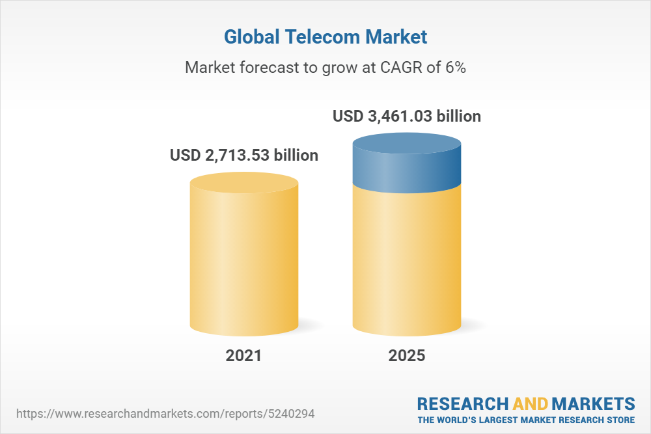
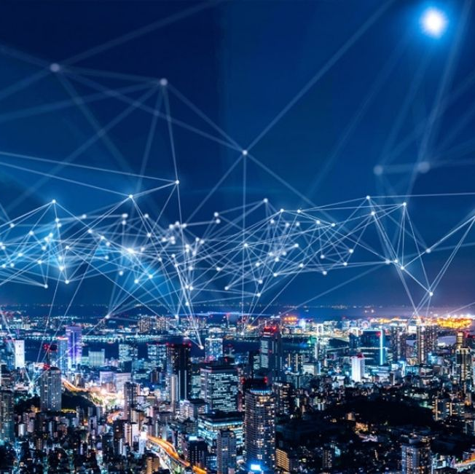
Introduction
The global telecom services market size was valued at USD 1,657.7 billion in 2020 and is expected to expand at a compound annual growth rate (CAGR) of 5.4% from 2021 to 2028.
One of the main drivers of this business is the movement in consumer preference toward smartphone devices and next-generation technologies. Other possible drivers of market expansion include an increase in mobile subscribers, and increased demand for value-added managed ser

Slide 5
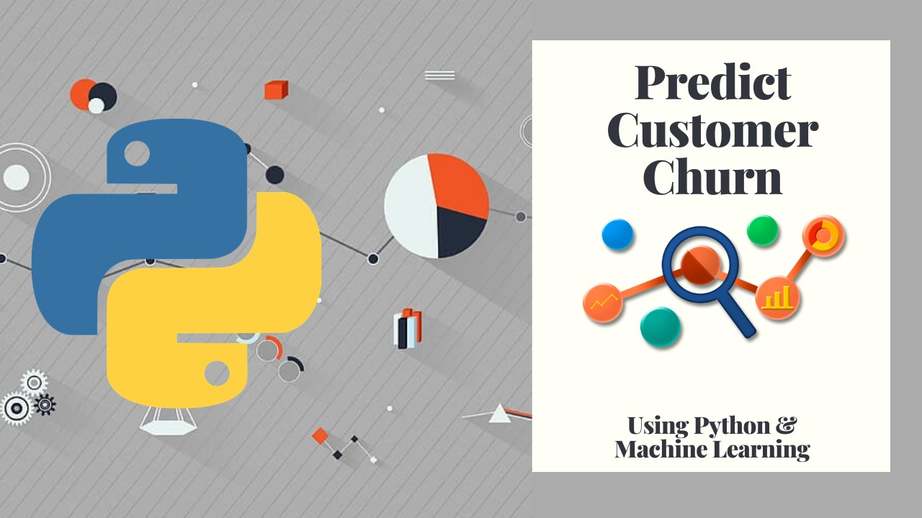
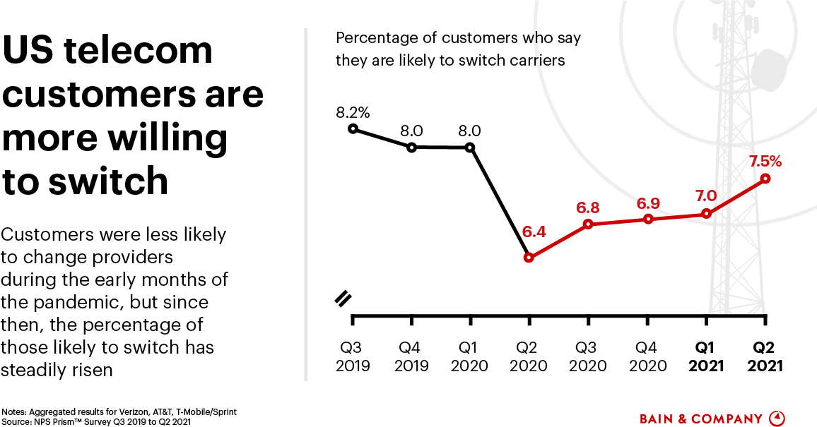

Customer Churn
According to Profitwell , the average churn rate in telecom businesses is 22% on average.

Slide 6
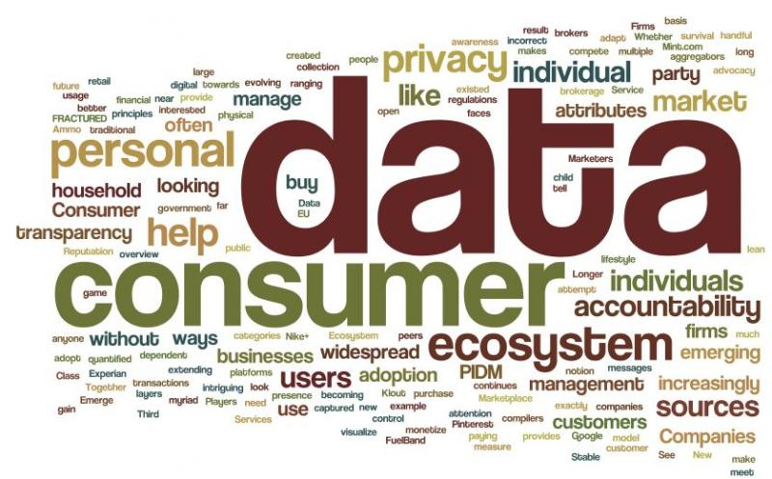
Data Description
Source
Description
It contains information about factors such as:
Services used
Payment method & Contact info
Customer demographics.
This data set contains information about a Telecommunication company that provided home phone and internet services to 7043 customers in San Diego, California in Q3.

Slide 7
Data Preprocessing
Exploring raw data
Started with 21 variables and 7043 observations.
Removed one unnecessary column which won’t contribute to building good model.
Identified missing values from observations and imputed them.
Understanding relationships
Built graphs to understand the relationship between various input variables and churn.
Cleaning data
Standardized the column titles.
Encoding
Used Dummy encoding as well as Ordinal encoding for input variables and Label encoding for target.

Slide 8
Input Predictors
Gender
Senior citizen
Partner
Tenure
Dependents
Multiple Lines
Internet Service
Online Security
Online Backup
Device Protection
Tech Support
Streaming TV
Streaming Movies
Contract
Paperless Billing
Payment Method
Monthly Charges
Total Charges
Phone Service

Slide 9
Data Processing
Train-test split
Data was divided in the ratio 70:30.
Random oversampling was performed
Normalizing Data
Standard scalar was used to normalize the data.
Data imbalance
Imputing Missing value
Missing data was imputed with mean value.

Slide 10
Trained Models
K-NN
Decision Tree
Random Forest
Ada Boosting
XG Boosting
Logistic
Neural Network
Gradient Boosting

Slide 11
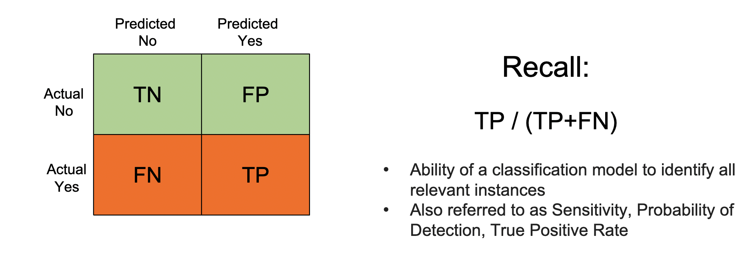
Metrics and Analysis
In this context,
True Positives – Number of customers that the model correctly predicted will churn. ***
False Positives - Number of customers the model predicted will churn but they didn’t. *
True Negatives - Number of customers whom the model correctly predicted will not churn. *
False Negatives - Number of customers that the model predicted will not churn but they did. ***
We are targeting the best Recall score for this problem with different models.
We will set the F-beta value of F2 which favor Recall, also considering precision.

Slide 12
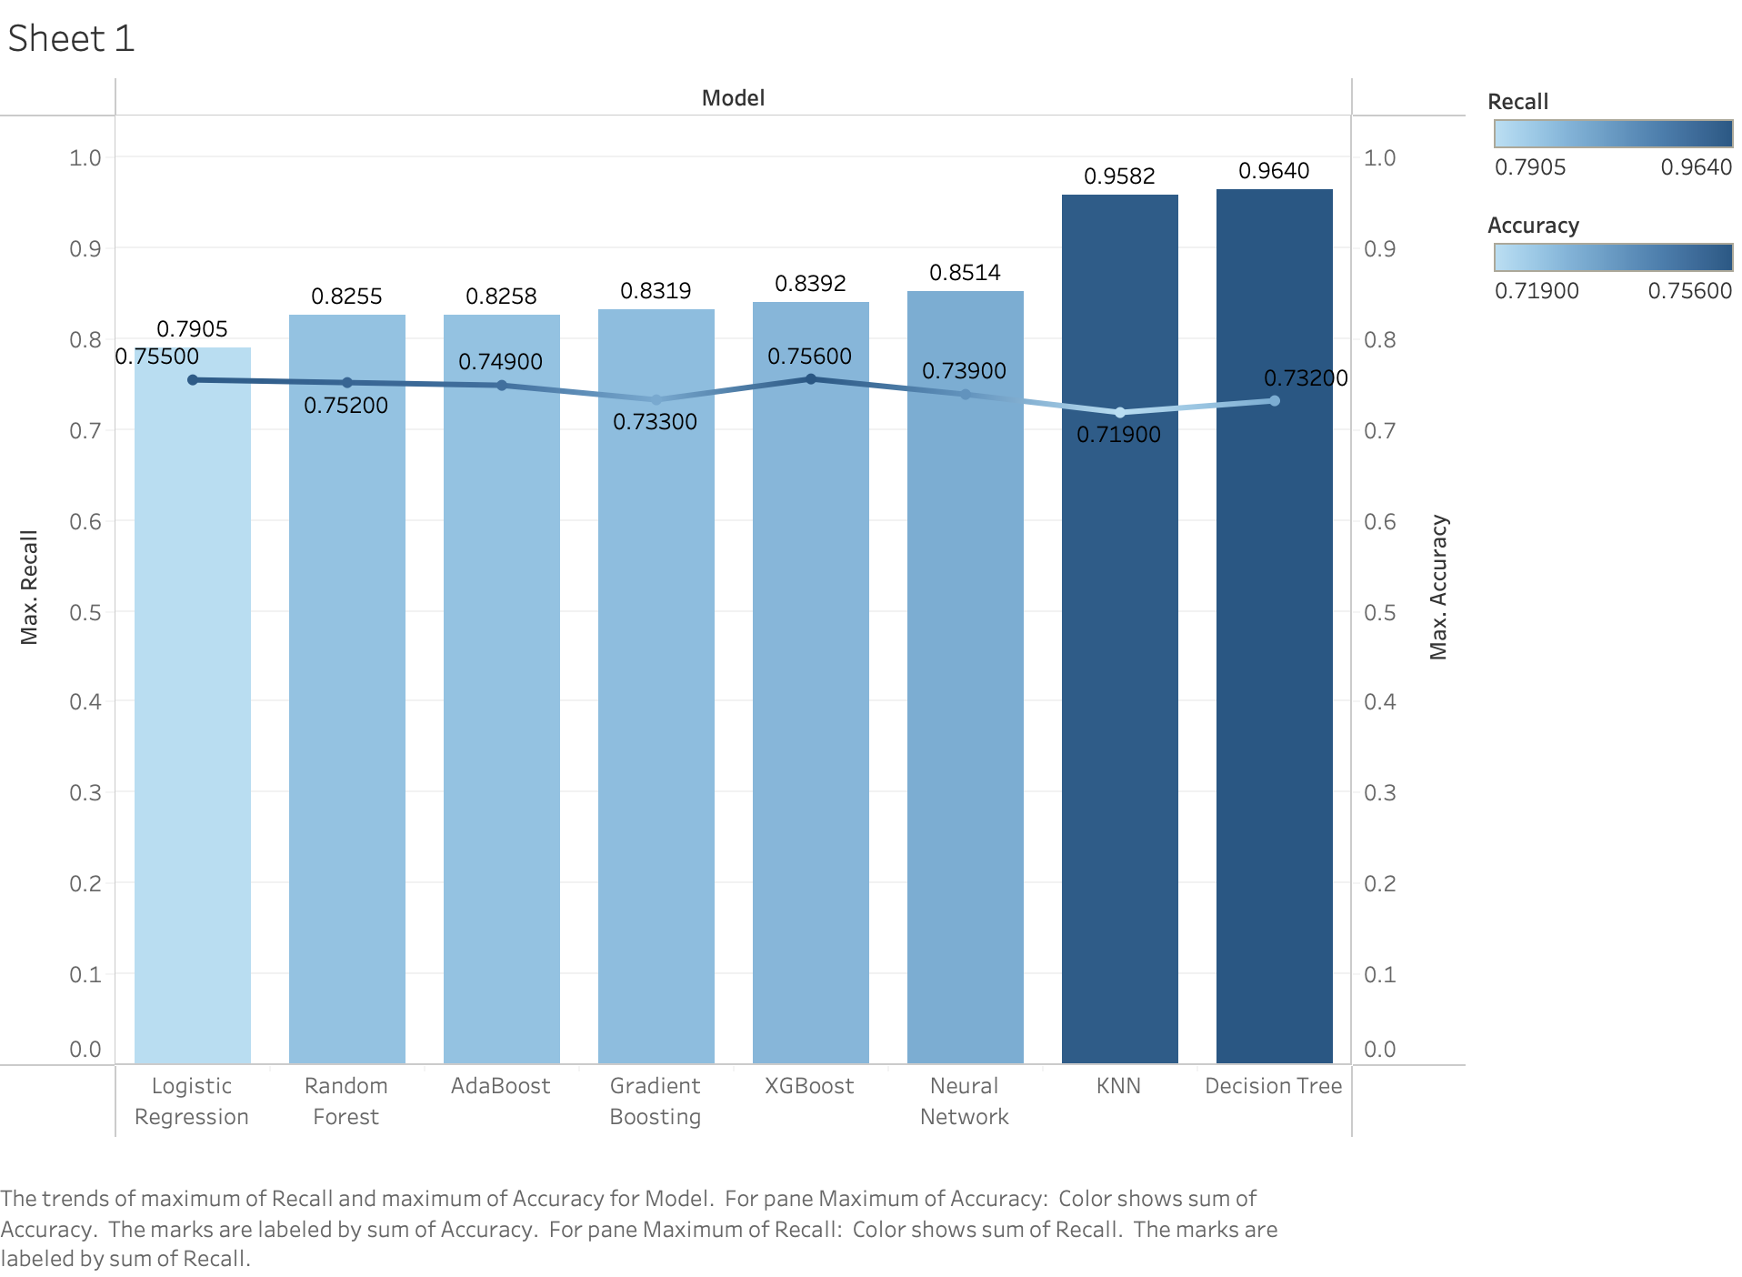
Model metrics comparison

Slide 13
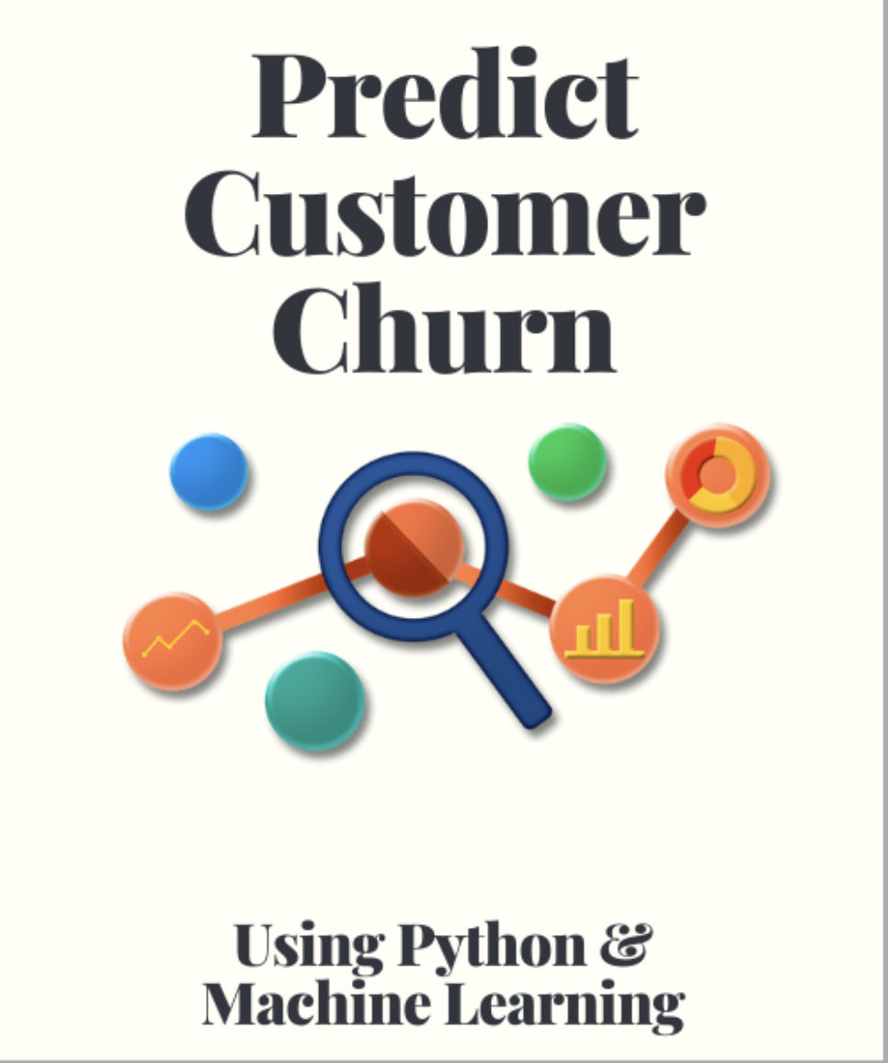
Outcome
Decision Tree model with hyper parameter tuning and K-fold cross validation gave us the best result
Recall : 96.40%
Accuracy: 73.20%

Slide 14
What can we do with analyzed churn data?
Focus on behavioral churn. Look for indicators before it’s too late.
1
Proactively approach customer before cancellation
2
Adjusting business models to consumer trends
3
Analyzing individual services and solving issues
4
Incentivize existing customers – Rewarding Loyal Customers
5

Slide 15
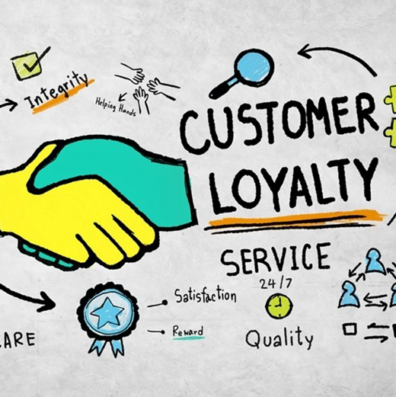

In the past…
Data like this has been used to identify customers who are likely to leave and incentivize them to stay be offering rewards to stay.
This does not build customer loyalty.

Slide 16
Scope for The Future

Slide 17
Planning for the future
Optimizing resources
Creating better business models
Reappropriating investment of resources for maximize the profitability
Predict customer behavior and alter business strategies accordingly
By evaluating current market trends that we can determine using data for enhancing the customer experience

Slide 18
There is so much more we can do!
The data is speaking to us… All we need to do is listen!

Slide 19
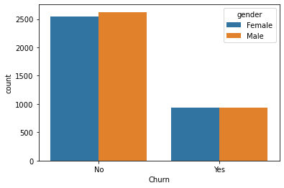
Does Gender influence Churn in any way?

Slide 20
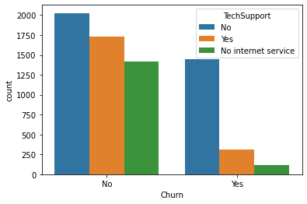
Can pro-active intervention reduce churn?

Slide 21
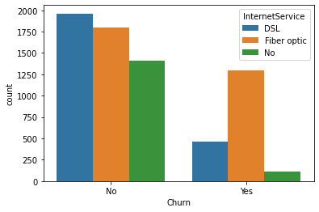
Are there services that are lacking in quality?

Slide 22
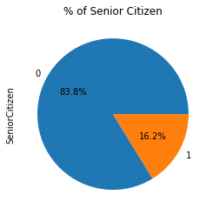

Who are out most loyal customers?

Slide 23
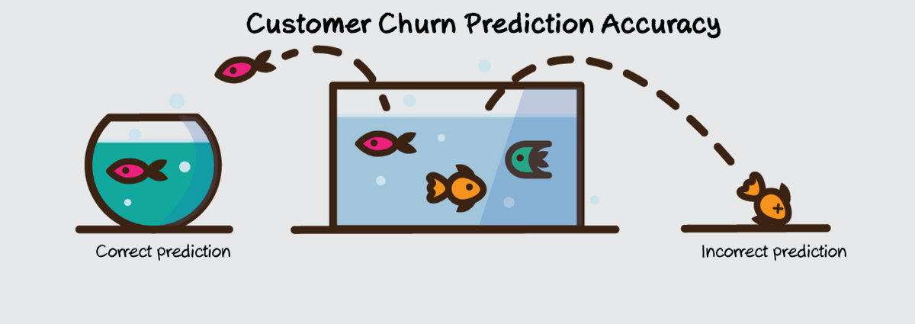
Summary
From the model data
We predict who among our customers are most like to churn.
Reduce the campaign cost by limiting target customers
Identify loyal customers
Identify flaws and improve customer satisfaction
Since Telecom Industry is multibillion-dollar business, addressing a minor issue improves the whole process by a large proportion will have a significant impact on revenue.

Slide 24
Thank you
Team SUPREME

